Slide 1

Micro mouse Competition
Using ESP32 microcontroller

Slide 2
Team Members
Jehad Hamayel 1200348
Musab Masalmah 1200078
Abd-Alkarim Eiss 1200015

Slide 3
Agenda
Introduction
Research and Planning
Simulation Part and Algorithms
Right-Hand rule Algorithm
Flood fill Algorithm
Hardware Part
Components
Microcontroller (ESP32)
Procedure and Testing
MicroPython using Thonny Program on ESP32
Testing of Components
Designing the Robot
Testing the Robot
PID Controller
The final Test in the maze
Conclusion and Future Plans

Slide 4
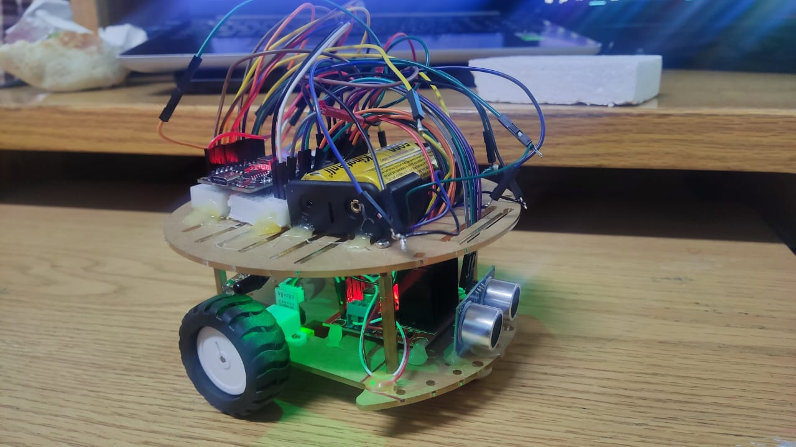
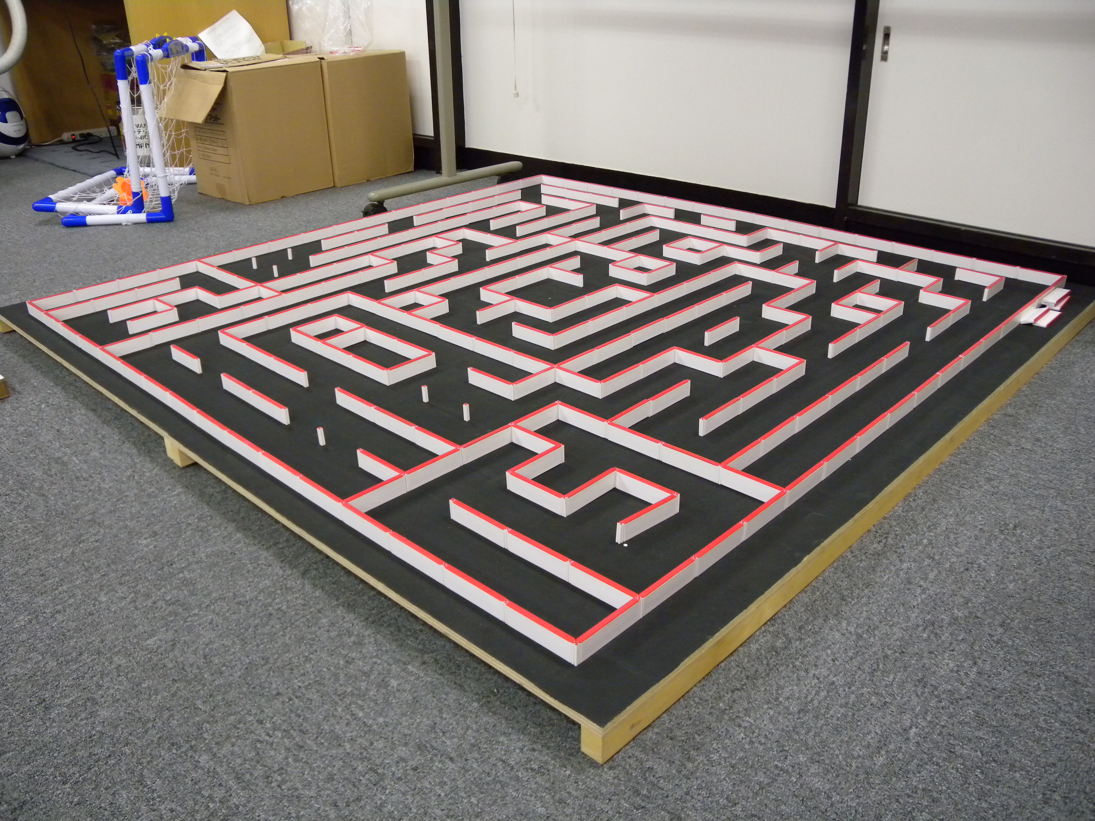
Introduction
This project aims to build a micro-mouse that will solve a maze according to a specific algorithms.
There are two parts: simulation and the practical part after imagining and learning what the robot will look like when built and how it works.

Slide 5
Research and Planning
Planning:
We held a meeting to determine an action plan for the coming days.
Search about components:
We researched the components needed to make our robot .
Search about algorithms:
We have done research on algorithms that we will apply to our robot to solve the maze.
Buying and testing:
We brought the parts, installed them, and tried them out.

Slide 6
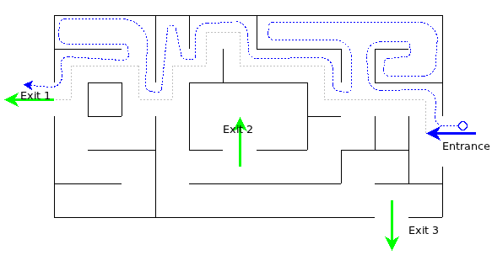
Simulation Part and Algorithms
Right-Hand Rule Algorithm:
It is one of the algorithms that are used to solve the maze and find the goal. When the micro-mouse enters the maze, it turns to the right direction if there is a wall.
This algorithm:
- If the micro-mouse faithfully follows the right wall, the exit will be found without fail.
Advantages:
- Simple to implement and understand.
- Sometimes finds the goal.
Disadvantages:
- Time consuming.
- It works according to the maze.
- Maybe finds or doesn’t find the goal (INFINT LOOP).

Slide 7
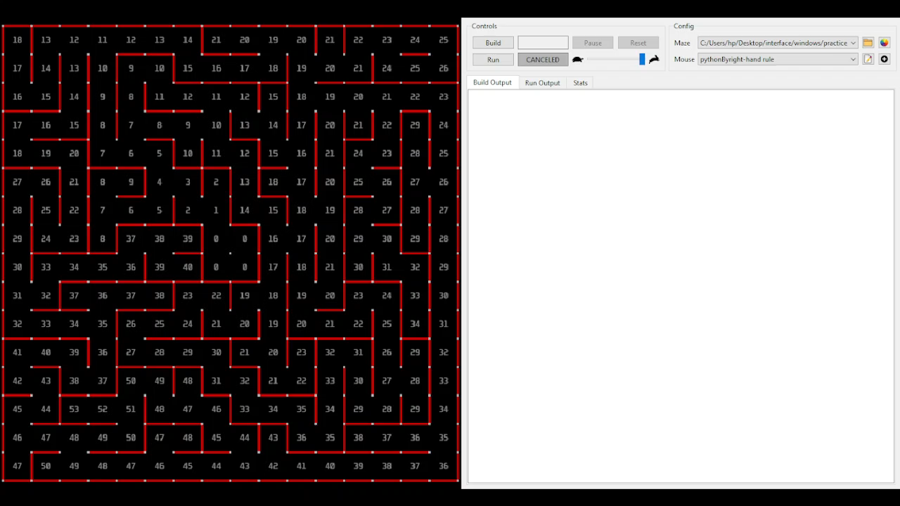
Right-Hand Rule Algorithm:

Slide 8
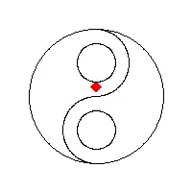
Simulation Part and Algorithms
Flood fill Algorithm
The flood filling algorithm is the famous algorithm that works on the principle of water flooding from a height, where it is distributed until it reaches a place in the fastest way, as in the project the Manhattan Destination was used to measure the distance.
Advantages: - One of the fastest algorithms in micro mouse maze solving algorithms. - It doesn't depend on visiting all nodes in the maze; he can reach the goal in a good time.
Disadvantages: - It still visits cells it has already visited. - Have a high cost for the cell’s cost updates.

Slide 9
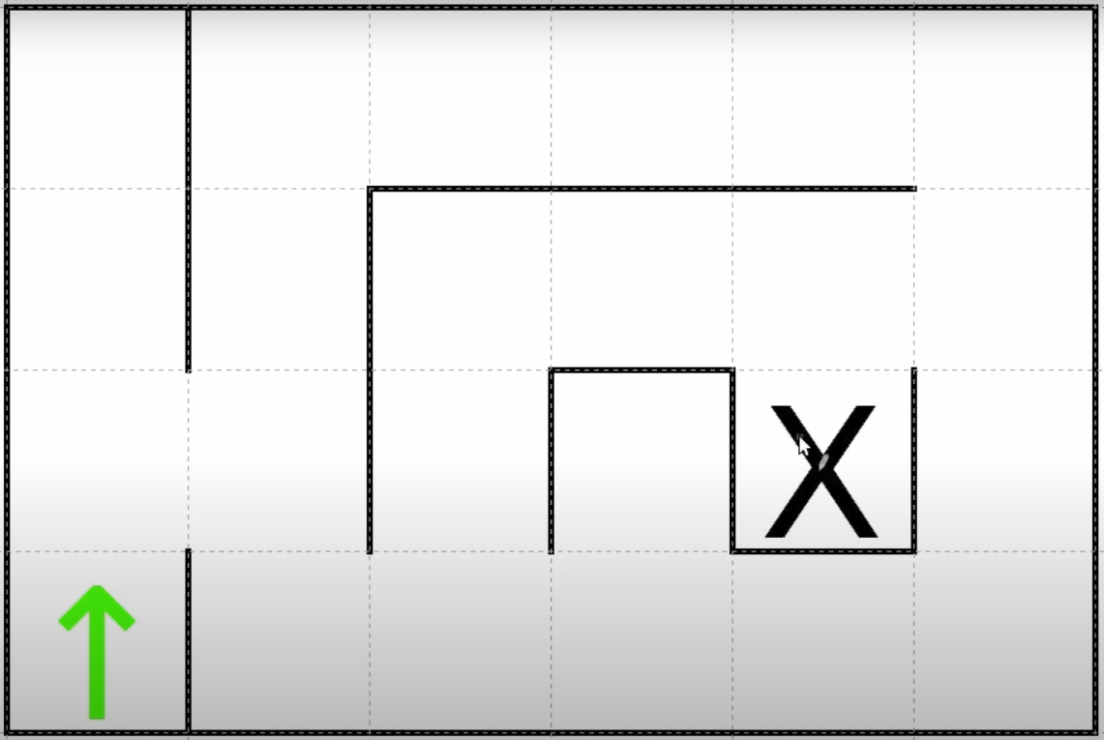
Pseudocode of the Algorithm of Flood fill Algorithm :
1. Add the current cell to the queue.
2. While the queue is not empty:
Take the front cell in the queue “out of line“ for consideration.
Get the front cell’s minimum value amongst accessible neighbors.
If the front cell’s value <= the minimum of its neighbors, set the front cell's value to minimum + 1 and add all accessible neighbors to the queue.
else, continue.

Slide 10

Flood fill Algorithm

Slide 11
Hardware Part
H-Bridge (L298N)
Ultrasonic Sensor
2 IR Sensors
2 DC Motors With Encoders and Wheels (N20)
Robot Base
Bread Board
Wires
2 Lithium Batteries (5000mA 4.2V)
Battery Holler

Slide 12
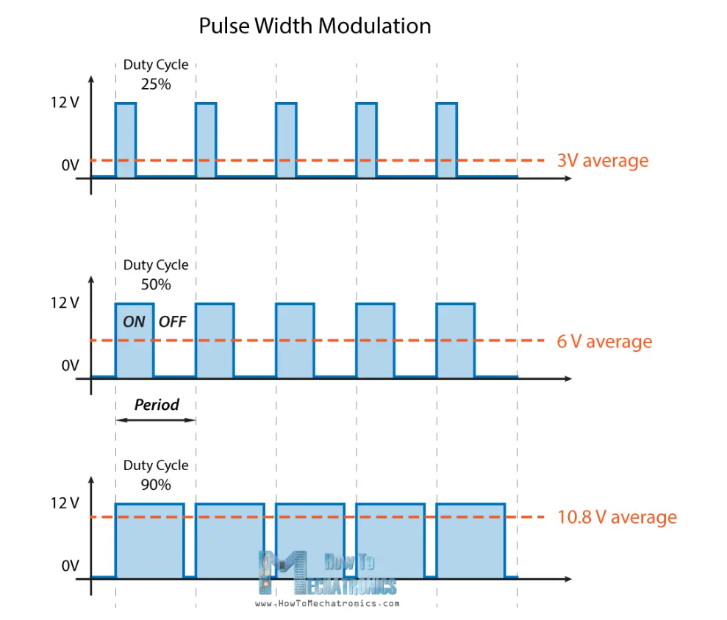
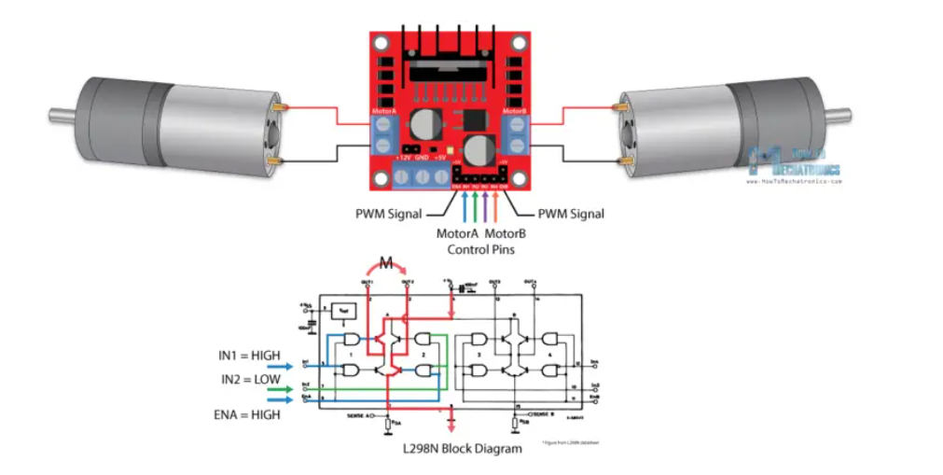
H-Bridge (L298N)
Two DC motors may be simultaneously controlled for both speed and direction according to the twin H-Bridge motor driver L298N. DC motors with a peak current of up to 2A and a voltage between 5 and 35V can be driven by this module.
The module has two screw terminal blocks for the motor A and B, and another screw terminal block for the Ground pin, the VCC for motor and a 5V pin which can either be an input or output. It has a 5V voltage regulator.
It has four pins to control the two motors, input1 and input2 for motor A also input3 and input4 for motor B. Moreover, it has Enable A and Enable B pins to control the speed of motors.

Slide 13
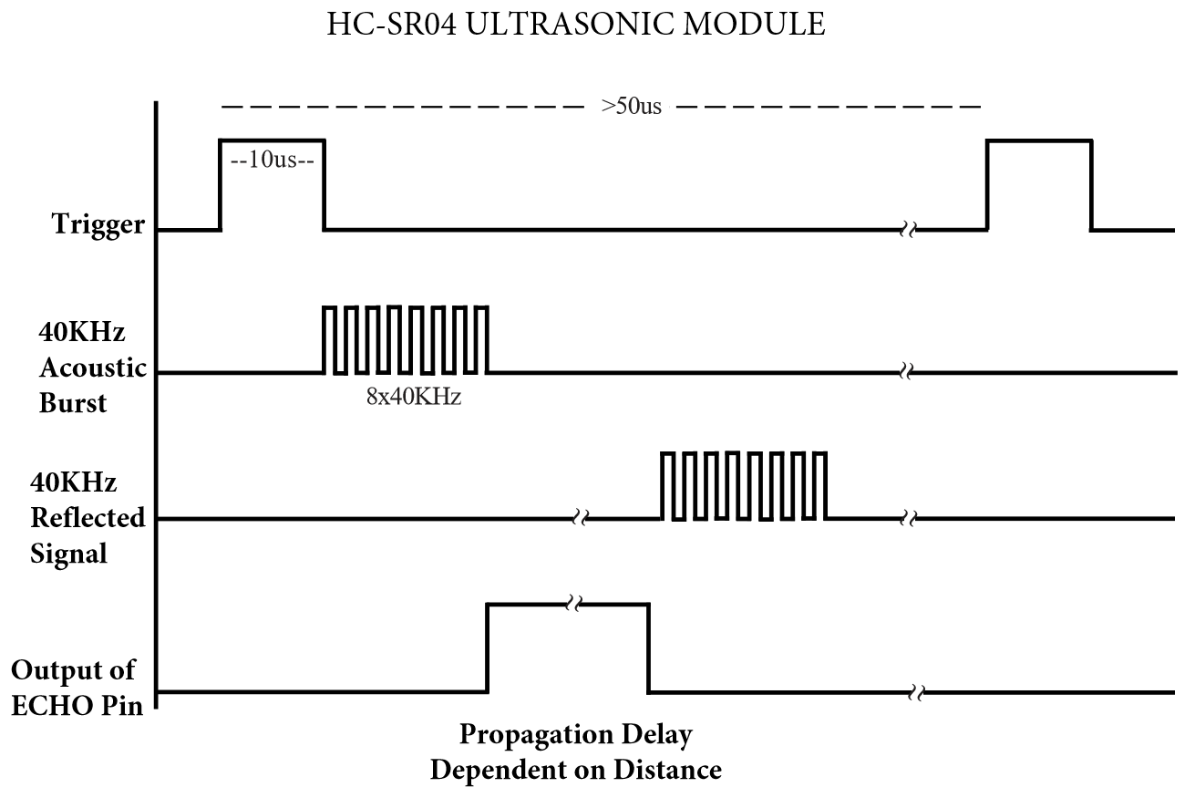
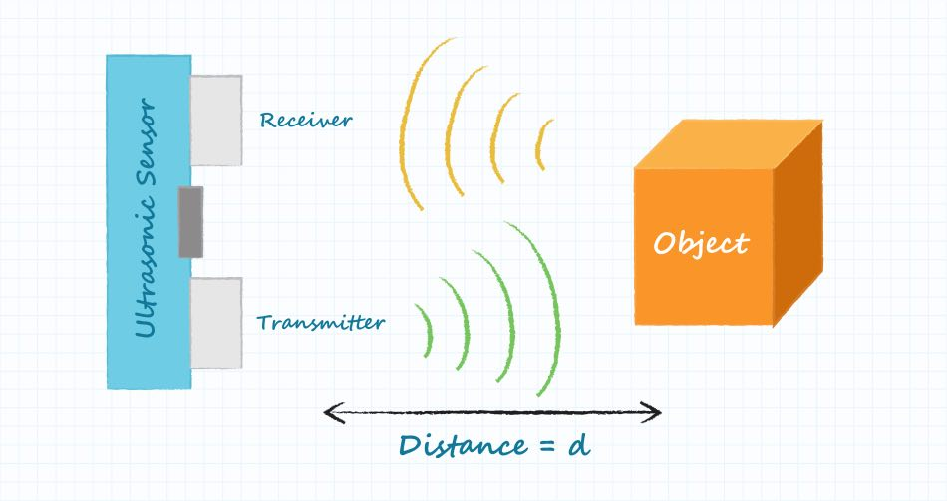
Ultrasonic Sensor
Ultrasonic sensors measure distance by using ultrasonic waves.
The sensor head emits an ultrasonic wave and receives the wave reflected back from the target.
Ultrasonic Sensors measure the distance to the target by measuring the time between the emission and reception. Distance L = 1/2 × T × S

Slide 14
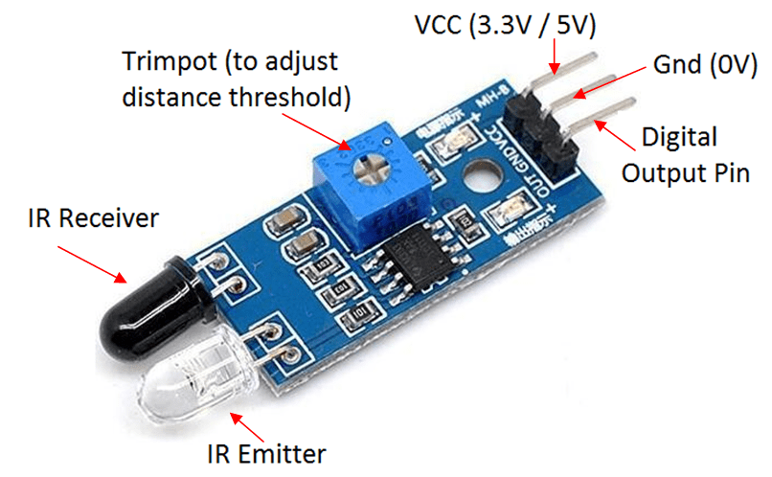
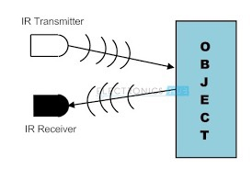
IR Sensor
This infrared sensor uses near-object sensing to detect beam reflection.
It contains an infrared transmitter and receiver that detects color to a greater extent than dark objects that do not usually block light.

Slide 15
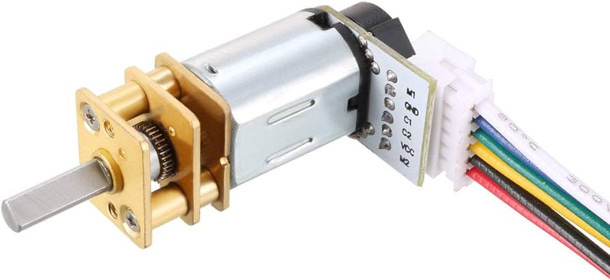
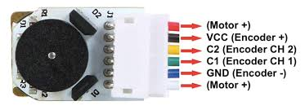
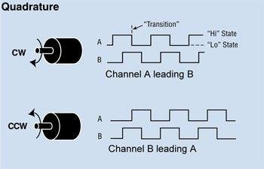
DC Motor With Encoder (N20 530 RPM)
What are magnetic encoders?
Magnetic encoders are a type of rotary encoder that use sensors to identify changes in magnetic fields from a rotating magnetized wheel or ring. there are 3 major components in a magnetic encoder:
Sensing Circuit A rotating wheel or ring A series of magnetic poles around the circumference of the wheel or ring.
As the wheel or ring spins past the magnetic sensor, the poles cause a predictable response in the sensor based on the strength of the magnetic field. The magnetic response is fed through a signal conditioning electrical circuit and output as a digital signal to the controlling device.
The number of magnetized pole pairs on the wheel pole, the number of sensors, and the type of electrical circuit all work together to determine the resolution of the magnetic encoder.

Slide 16
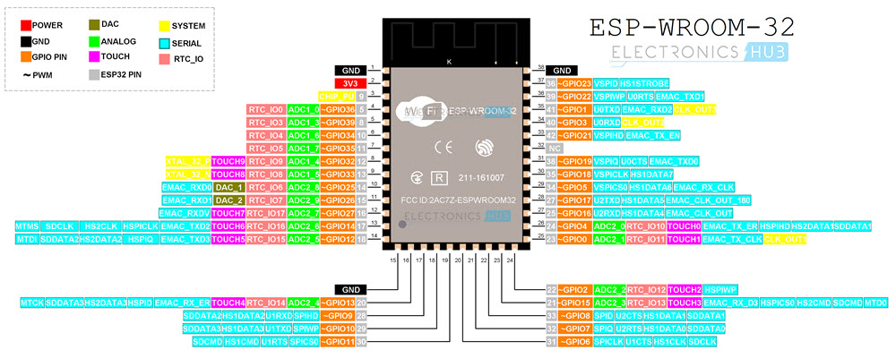
Microcontroller (ESP32)
ESP32-WROOM-32 is a powerful, generic Wi-Fi + Bluetooth + Bluetooth LE MCU module that targets a wide variety of applications, ranging from low-power sensor networks to the most demanding tasks, such as voice encoding, music streaming, and MP3 decoding.
At the core of this module is the ESP32-D0WDQ6 chip. The chip embedded is designed to be scalable and adaptive. Two CPU cores can be individually controlled, and the CPU clock frequency is adjustable from 80 MHz to 240 MHz.
The chip also has a low-power coprocessor that can be used instead of the CPU to save power while performing tasks that do not require much computing power, such as monitoring peripherals. ESP32 integrates a rich set of peripherals, ranging from capacitive touch sensors, SD card interface, Ethernet, high-speed SPI, UART, I2S, and I2C.

Slide 17
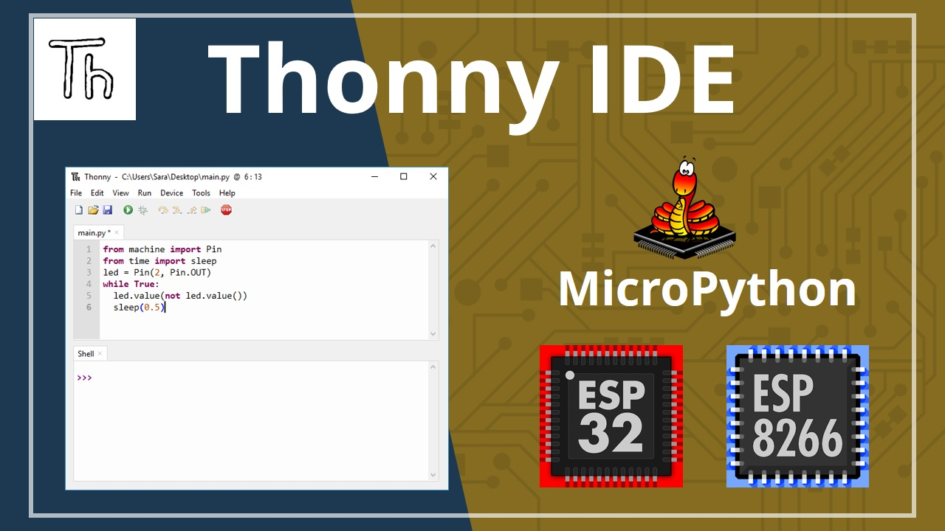
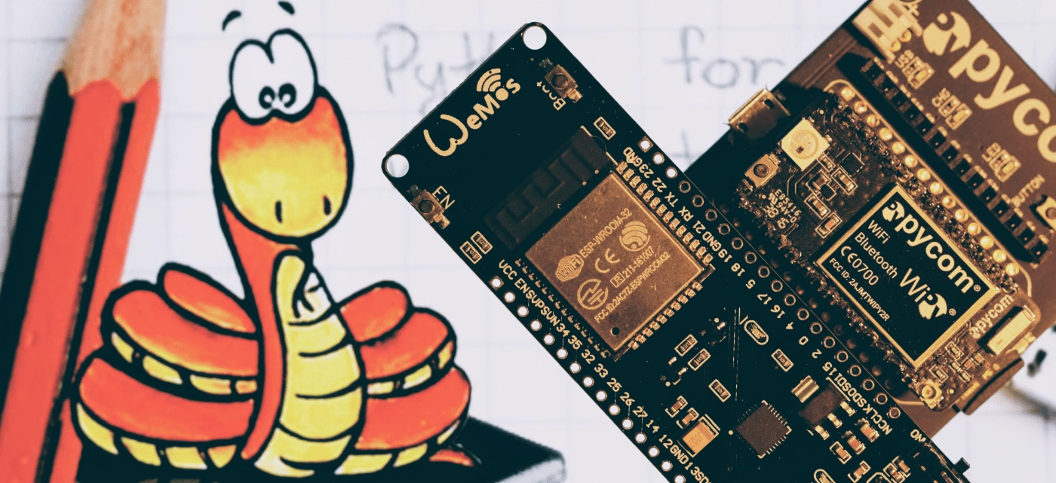
Procedure and Testing
MicroPython using Thonny Program on ESP32
We have tried something new and beautiful, which is using Python on the piece and conducting experiments on the pieces through this program. Such as Wi-Fi via the socket that we learned in the Networking course.

Slide 18
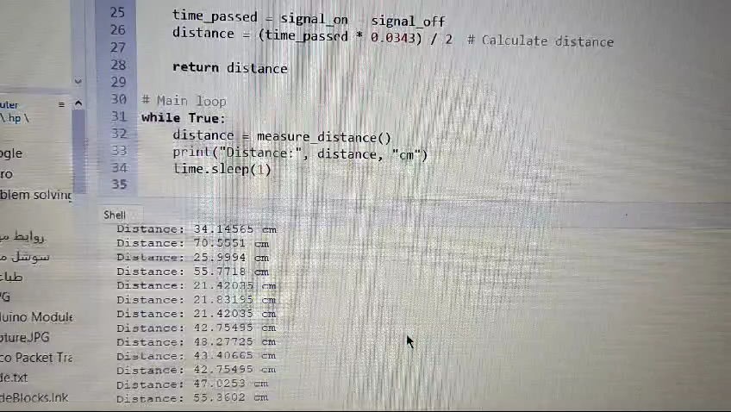
Testing of Components
Test Ultrasonic Sensor:

Slide 19
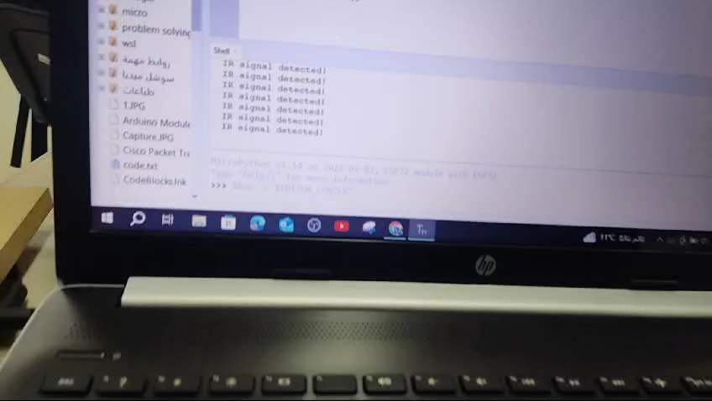
Testing of Components
Test IR Sensor After calibration:

Slide 20
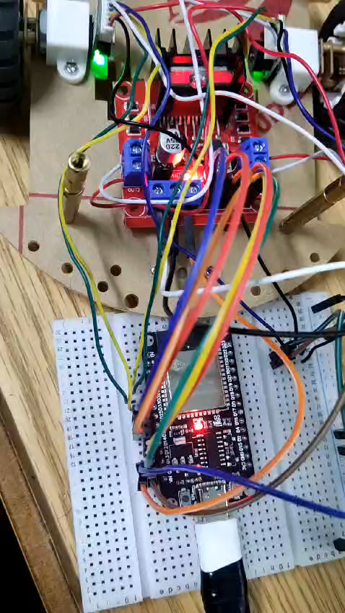
Testing of Components
Test Motors and H Bridge:

Slide 21
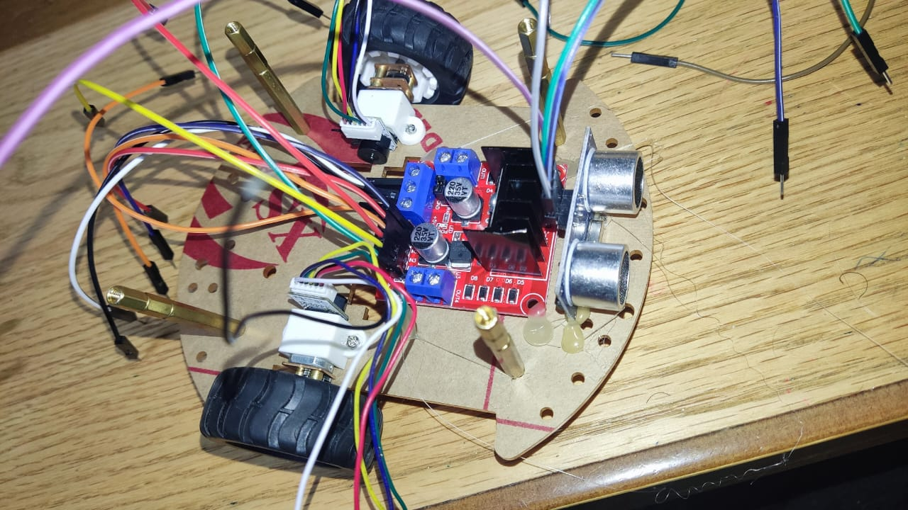
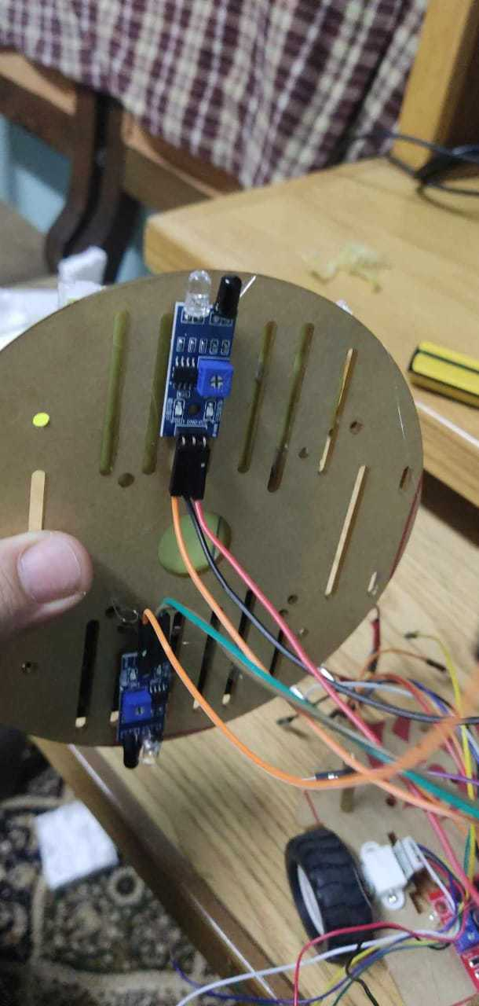
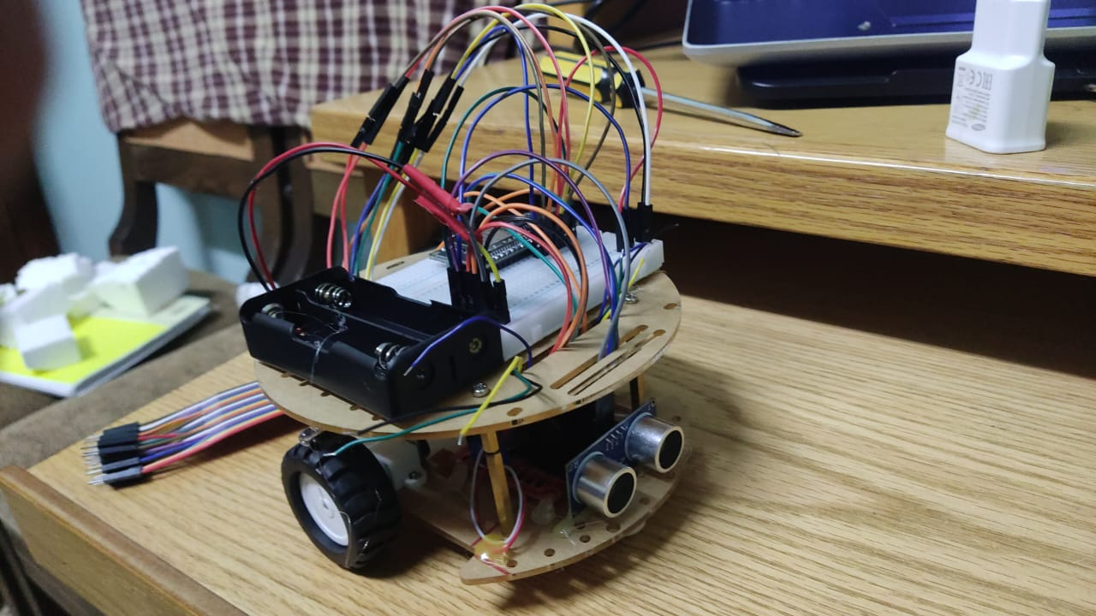
Designing the Robot
Build the lower part of the robot: After an initial experiment with the shape of the robot, we agreed to build a new shape for the robot that includes the h bridge, ultrasonic, and motors in the basement, as in the cover.
Build the upper part of the robot: The contents of the second floor are: from the bottom, the IR sensor, and from the top, the battery and the pasteboard, plus I cut the post so that it fits the shape and is suitable, but we made some modifications that we will mention later.

Slide 22
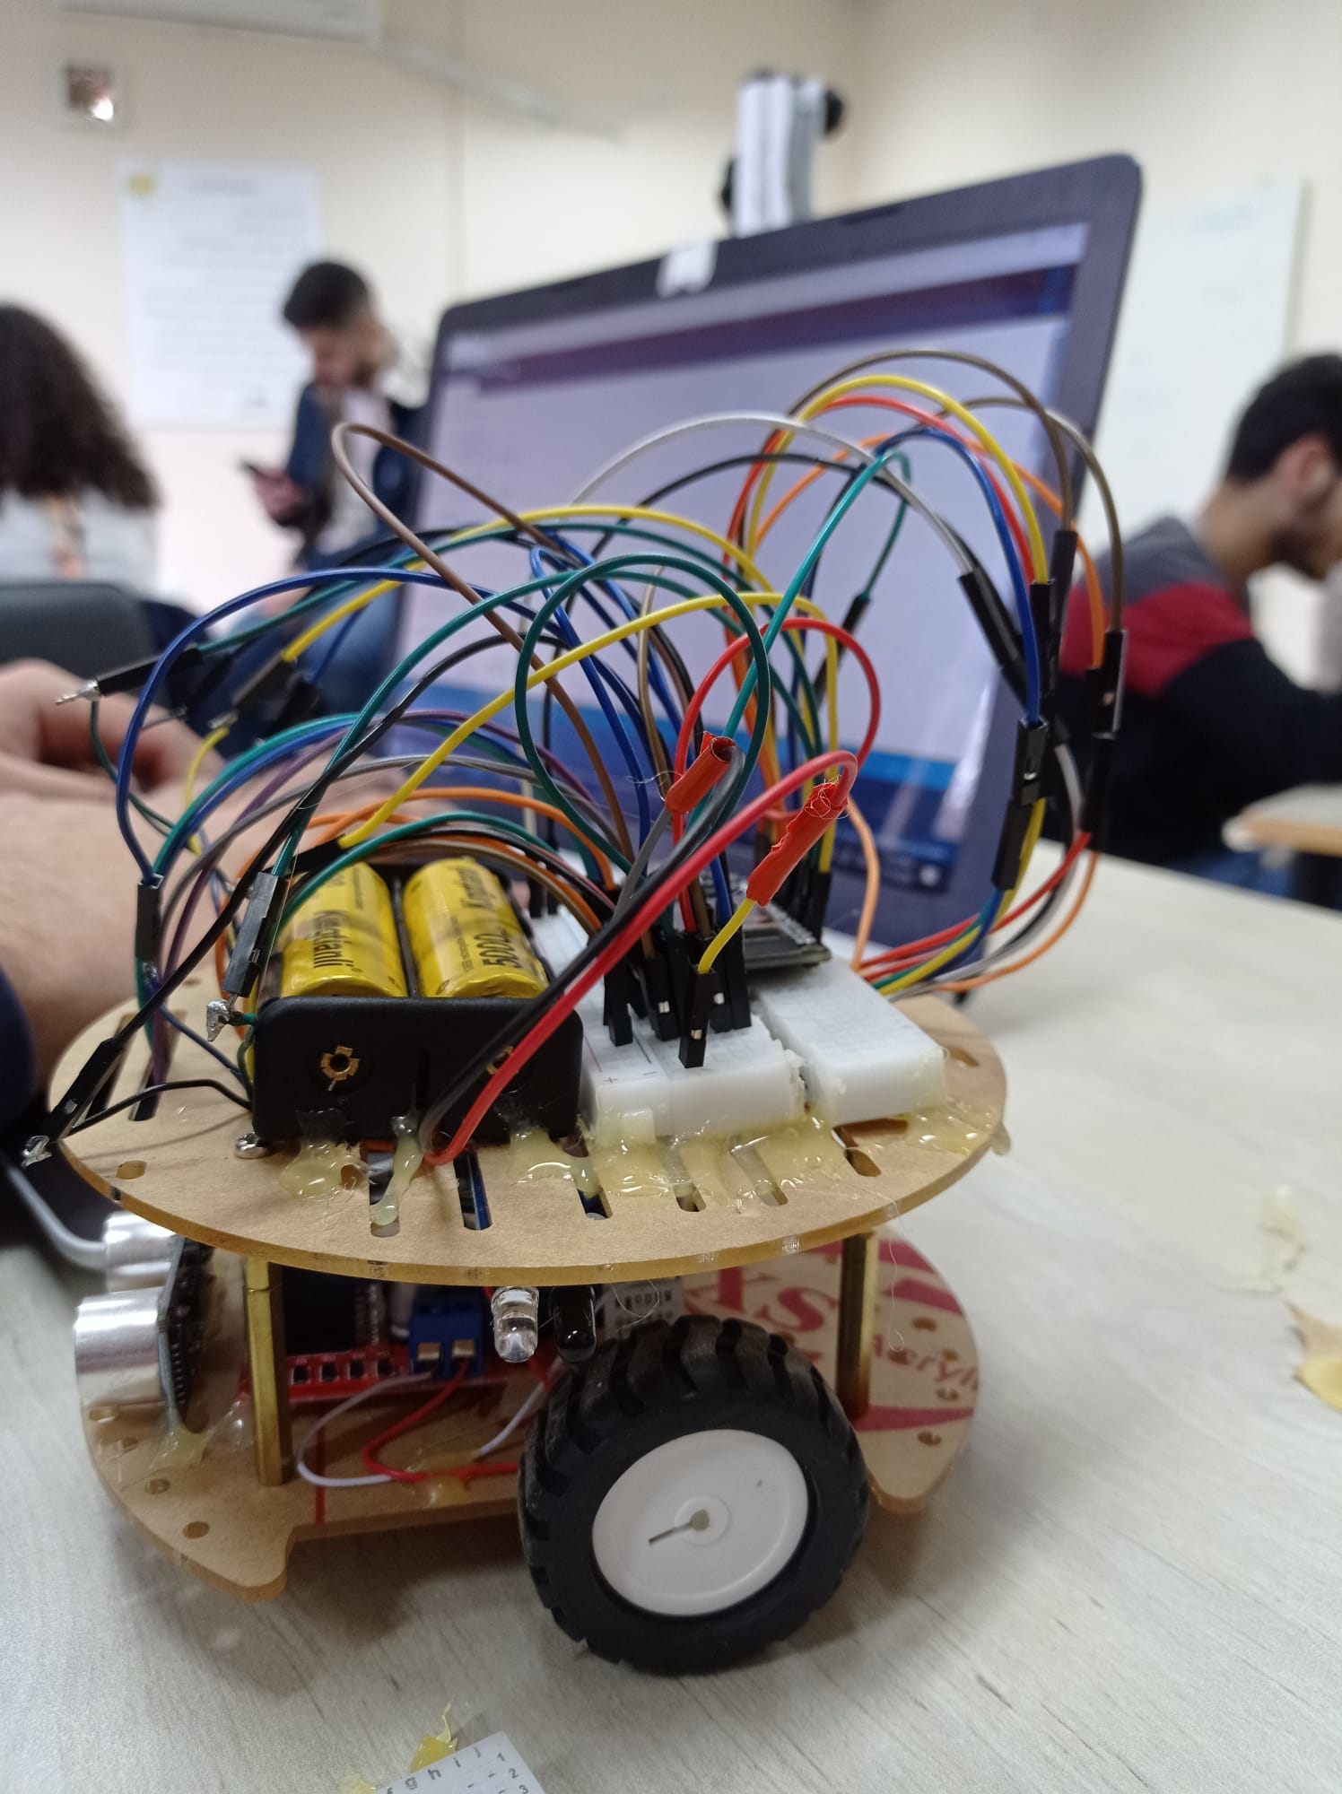
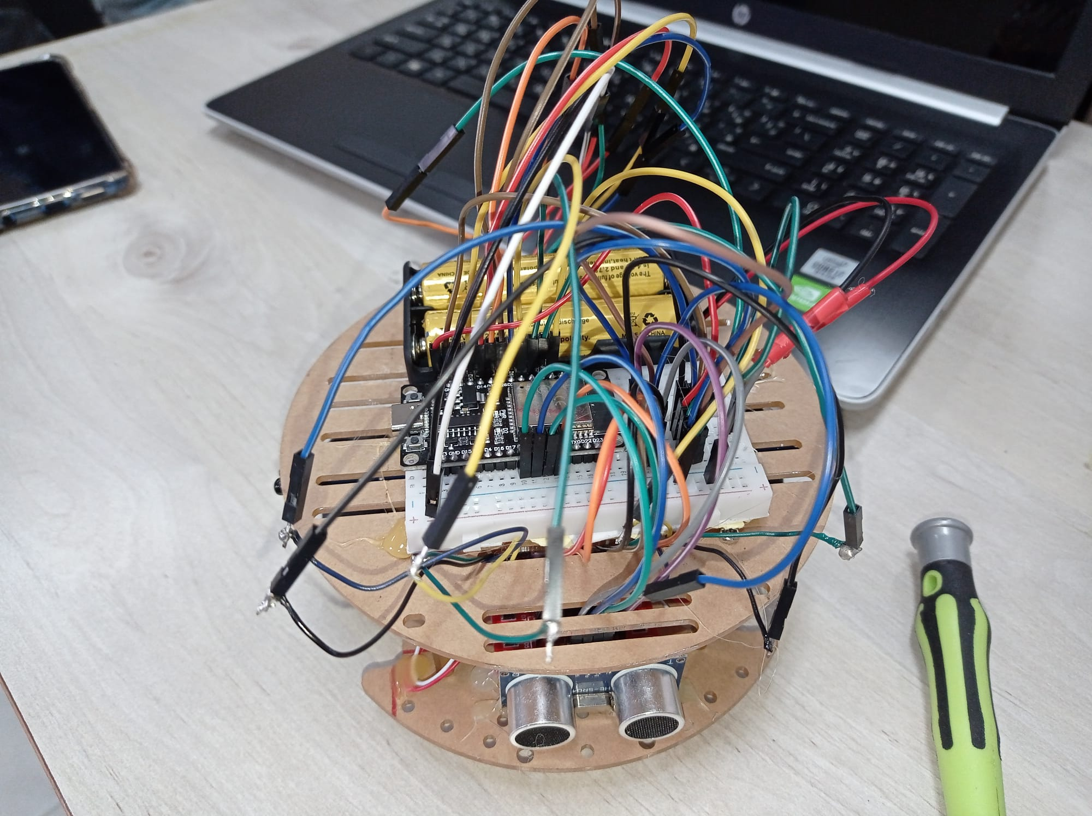
Designing the Robot
The Design of Robot Before the Redesigning and Rebalancing Process
The Design of Robot Before the Redesigning and Rebalancing Process

Slide 23
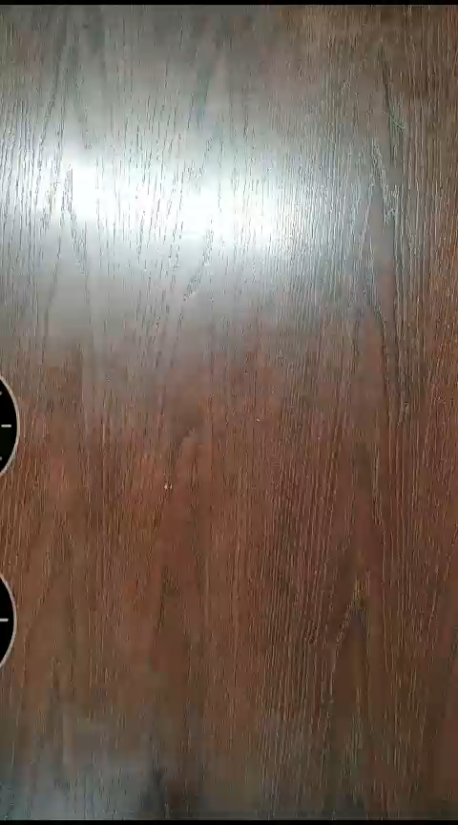
Testing the Robot:
The first forward movement of the robot.

Slide 24
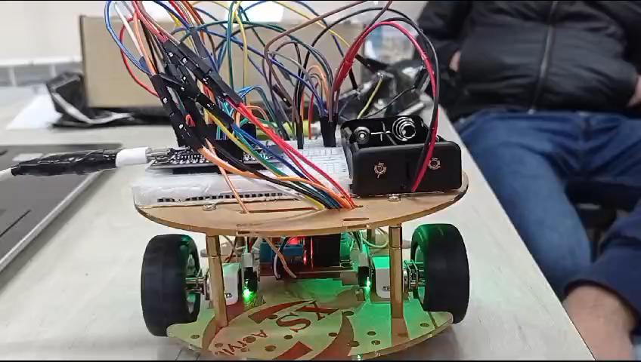
Testing the Robot:
Testing using Type-c Cable Connection: In this part, there is an attached video showing when we tested the whole robot via a type-C cable connection with the laptop at the laboratory before the redesigning process and the replacement of the motor and the wheel of the right part.

Slide 25
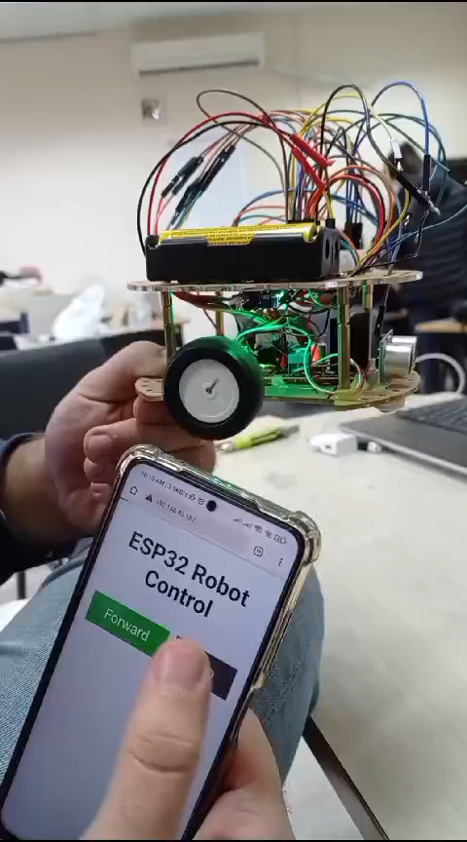
Testing the Robot:
Testing using Wi-Fi connection: In this part, there is an attached video showing when we tested the whole robot via Wi-Fi connection and by using an HTML web page at the laboratory before the redesigning process and the replacement of the motor and the wheel of the right part.

Slide 26
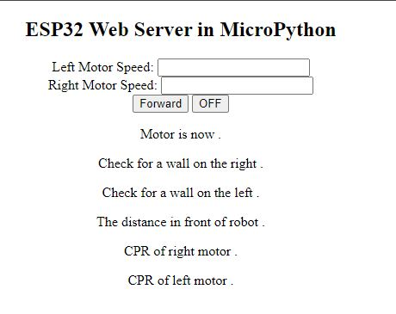
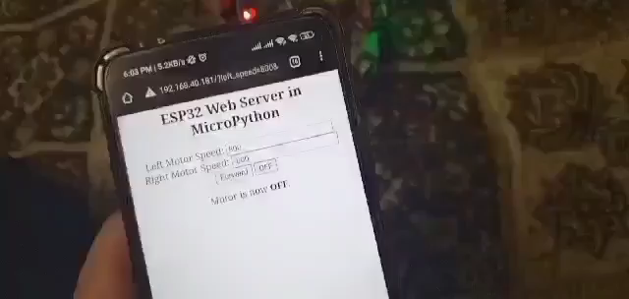
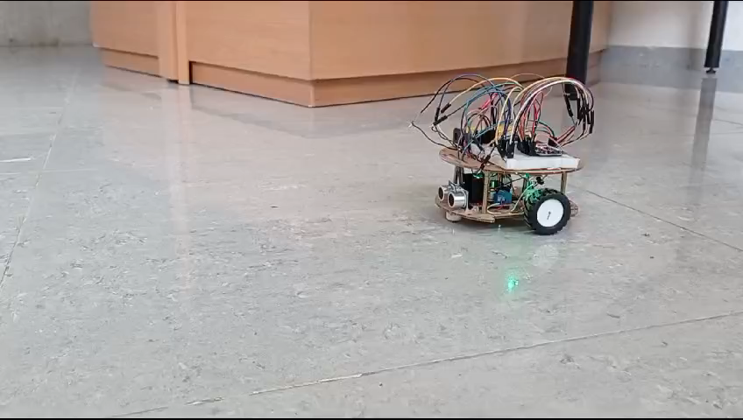
Testing the Robot:
Testing the correctness work of the Motors and wheels also the whole robot via Wi-Fi connection and by using a html web page: In this part, there is an attached video showing when we tested the correctness of the motors and wheels, as well as the whole robot via a Wi-Fi connection and by using an HTML web page at the laboratory before the redesigning process and after the replacement of the motor and the wheel of the right part. We found that all components in the robot worked correctly and as expected. But we faced a problem in the design of the robot. The problem was in balancing the weights of the components and finding the proper location of each one. PM.mp4

Slide 27
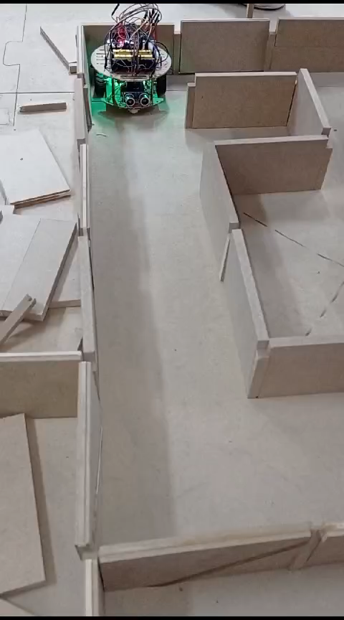
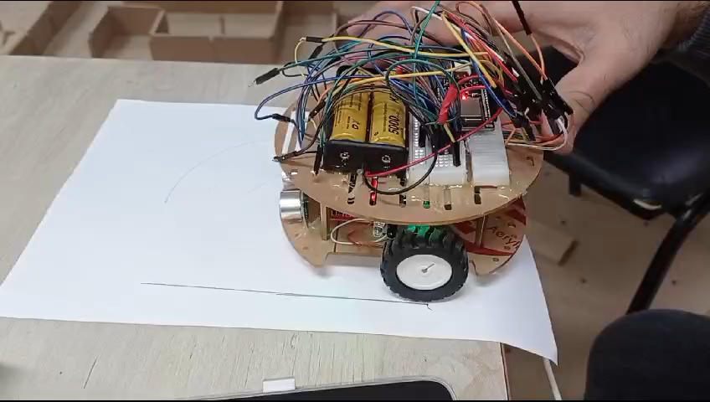
Testing the Robot:
The first successful move Forward using CPR
CPR calculation for Forward Movement:

Slide 28
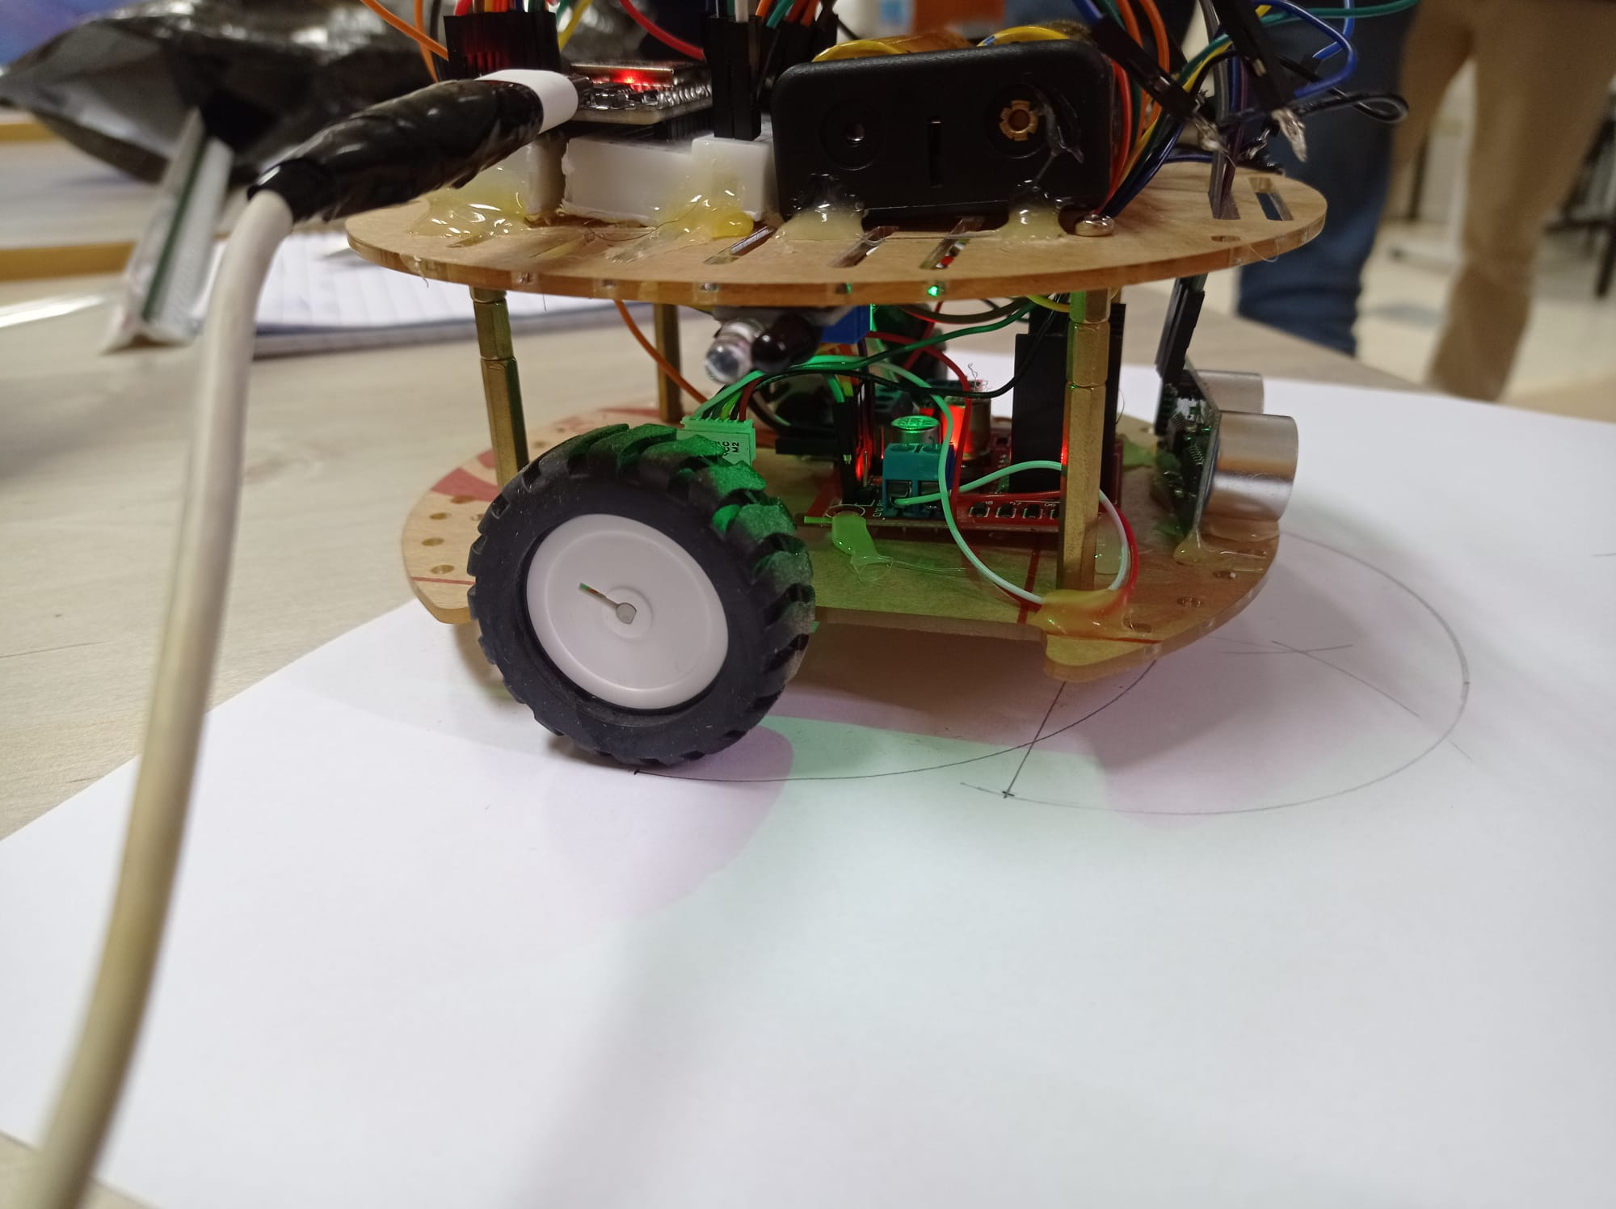
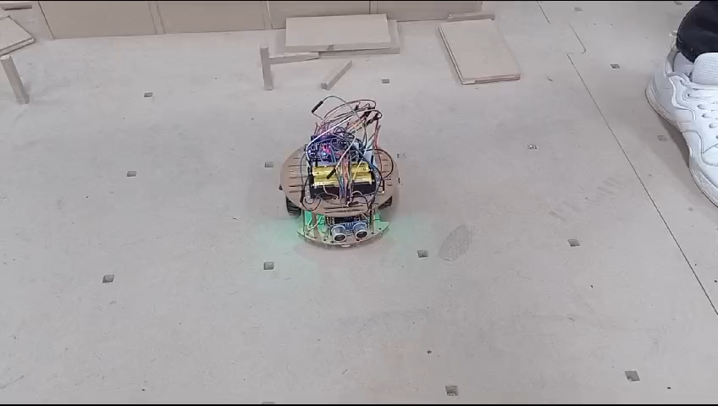
Testing the Robot:
The first successful move Right using CPR
CPR calculation for Right Movement:

Slide 29
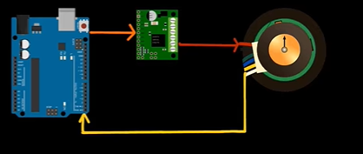
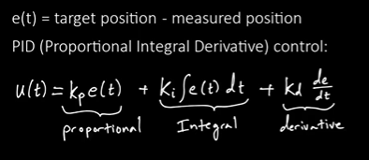
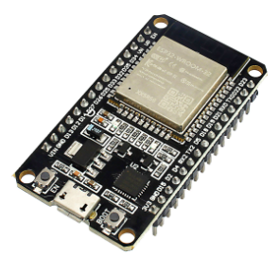
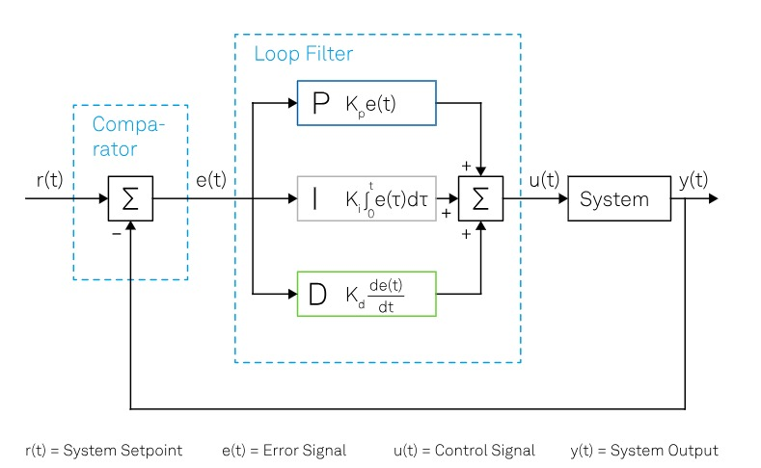
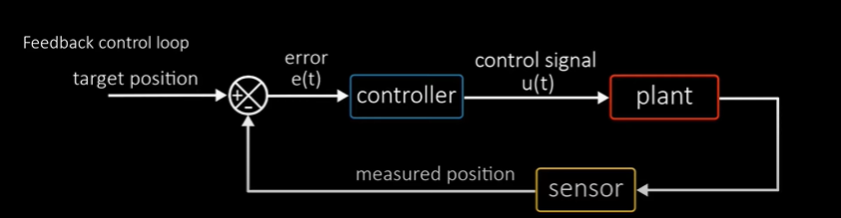
PID (Proportional-Integral-Derivative) Controller
ADV of PID: One of the main advantages of PID controllers is that they can be implemented without knowledge or a detailed model of the system. Thanks to heuristic calibration procedures, it is possible to calculate coefficients based only on simple experimental tests to be carried out directly on the process. Nevertheless, the initial tuning of the PID parameters can be a delicate task.

Slide 30
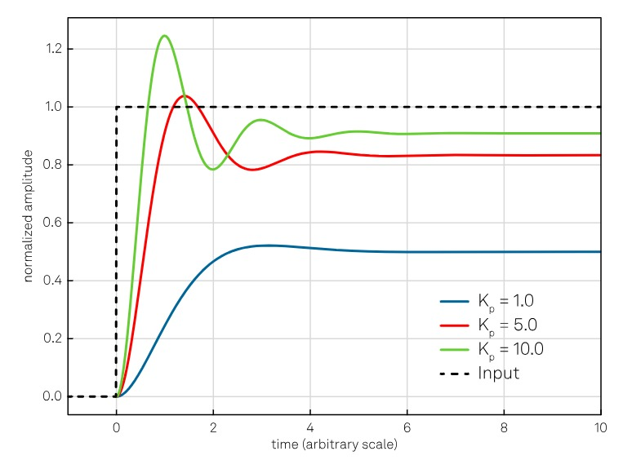
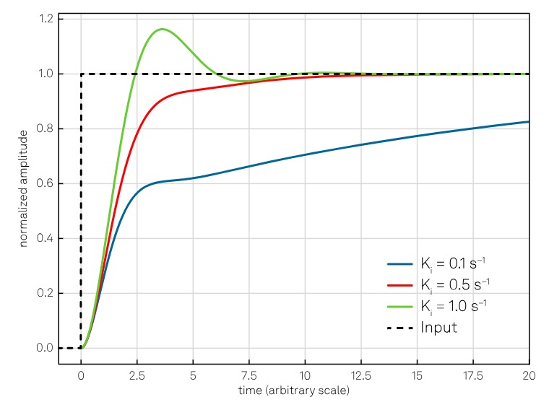
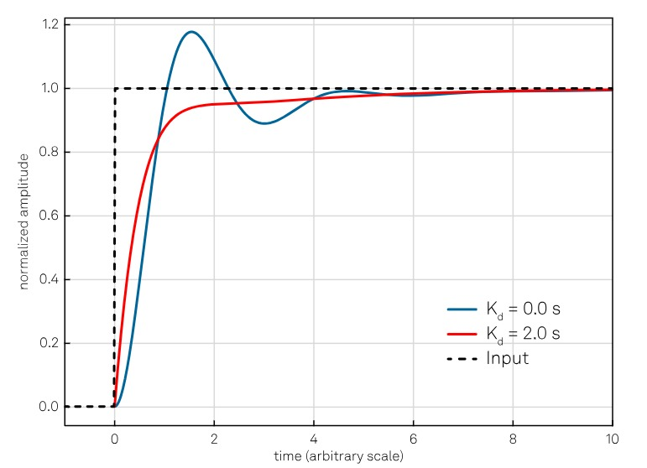
PID coefficients:
Proportional (P) coefficient (Kp) adjusts the immediate correction based on the current error.
Integral (I) coefficient (Ki) regulates the integration of accumulated errors over time to eliminate steady-state errors.
Derivative (D) coefficient (Kd) governs the rate of change of the control action to dampen oscillations and improve stability.

Slide 31
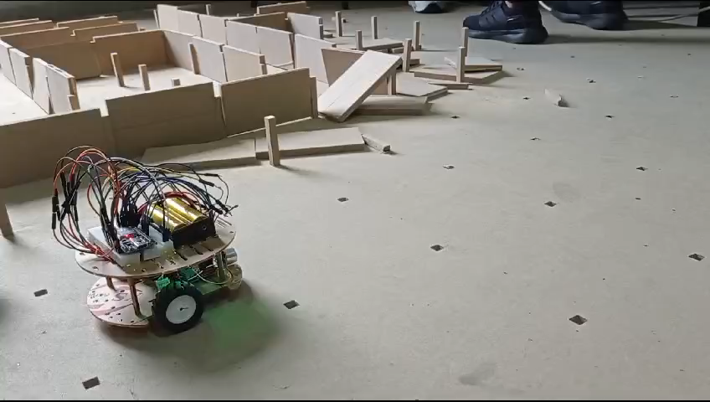
PID First Move:

Slide 32
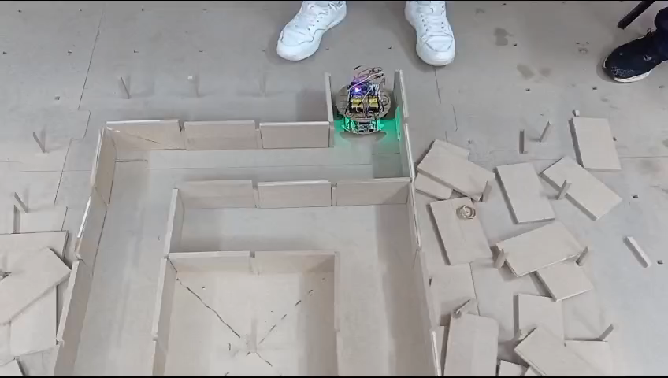
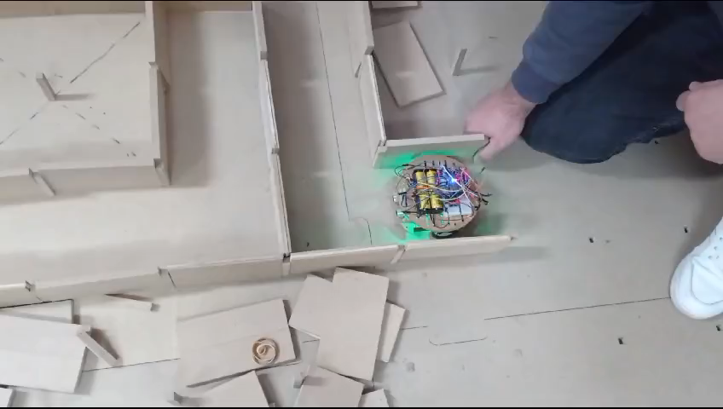
Testing the Robot:
The first test in the maze using right hand rule

Slide 33
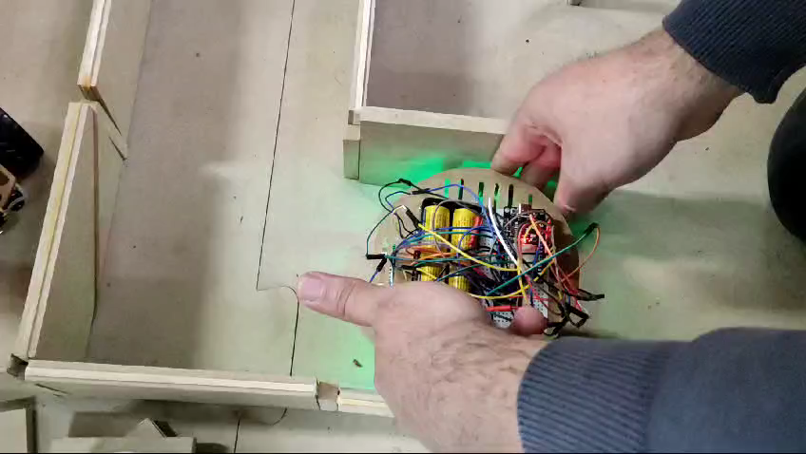
The final Test in the maze

Slide 34
Conclusion and Future Plans
In conclusion, this project opened new horizons for us and we learned new things in the world of hardware and robotics due to the extensive research on topics and their experience on the ground.
Future Plans:
Uninterruptible Power Supply(UPS)
Gyroscope
PID with UPS

